Slide 1
E-week of Fair and Sustainable Tourism for All
It’s not about the holiday;
it’s what the holiday brings.
Tourism as a Vector of Wellbeing
A Post-Covid Perspective
Rosemary Teed, Founder/Director
Magical Getaway Foundation
Australia

Slide 2
E-week of Fair and Sustainable Tourism for All
It’s not about the holiday;
it’s what the holiday brings.
The Magical Getaway Foundation (MGF)
is the only national charity dedicated to gifting first ever getaways/holidays to Australian children and their families;
to bring hope.

Slide 3
E-week of Fair and Sustainable Tourism for All
It’s not about the holiday;
it’s what the holiday brings.
Based in Melbourne, Australia
Commenced in August 2013
Ambassadors - Kat Stewart & Steven Bradbury OAM
Inaugural Australian member of the ISTO
Relationship established with the Family Holiday Association, UK

Slide 4
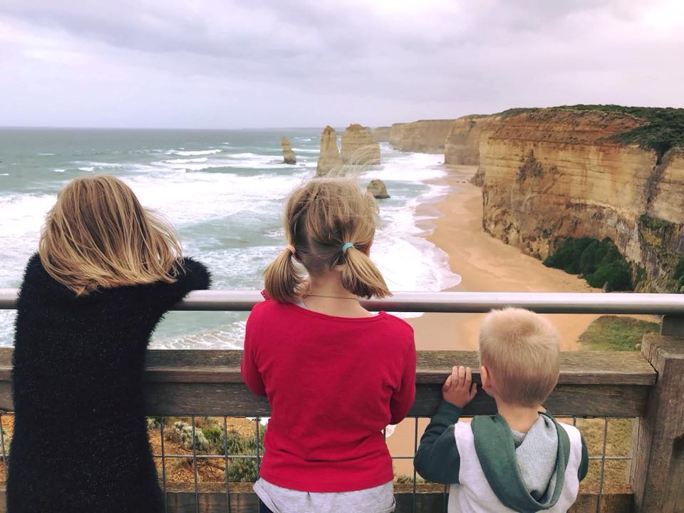
E-week of Fair and Sustainable Tourism for All
It’s not about the holiday;
it’s what the holiday brings.
1 in 3 Australian children have never been on a getaway/holiday.
Swinge Family Holiday, Dec 2017

Slide 5
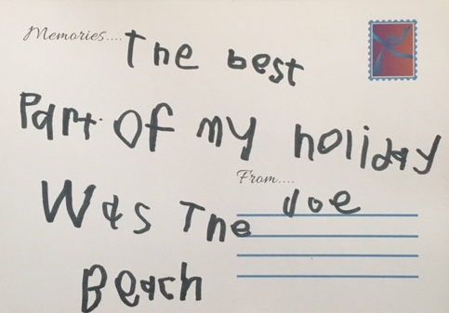
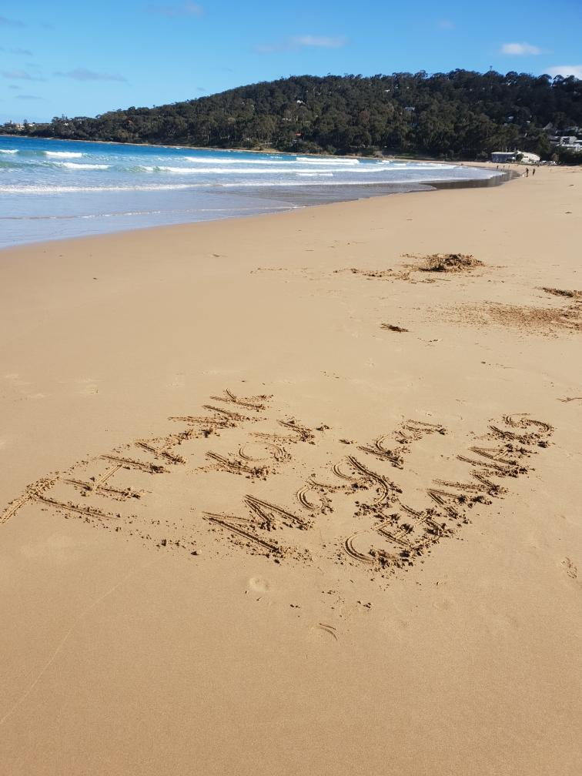
E-week of Fair and Sustainable Tourism for All
It’s not about the holiday;
it’s what the holiday brings.
First Ever Getaways/Holidays
Eligibility Criteria
Never been on a getaway/holiday
Prepared to tell their story to the Foundation; to share with others

Slide 6
E-week of Fair and Sustainable Tourism for All
It’s not about the holiday;
it’s what the holiday brings.
First Ever Getaways/Holidays
Family Issues
Domestic Violence
Homelessness / Unemployment
Kinship Care / Family Breakdown
Medical / Disabilities
Sexual Abuse / Other

Slide 7
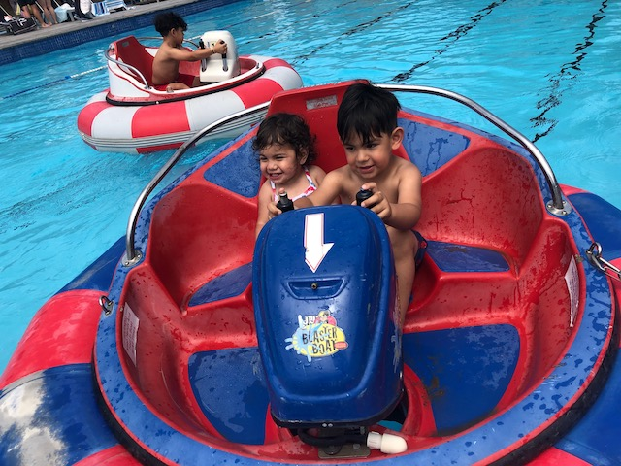
E-week of Fair and Sustainable Tourism for All
It’s not about the holiday;
it’s what the holiday brings.
First Ever Getaways/
Holidays Overview
Referred by organisations
Fully funded to locations in Australia
Visits to 3 local tourist attractions included
7 days/6 nights maximum time
Joyce Family Holiday, December 2018

Slide 8
E-week of Fair and Sustainable Tourism for All
It’s not about the holiday;
it’s what the holiday brings.
It’s not about the holiday;
it’s what the holiday brings.

Slide 9
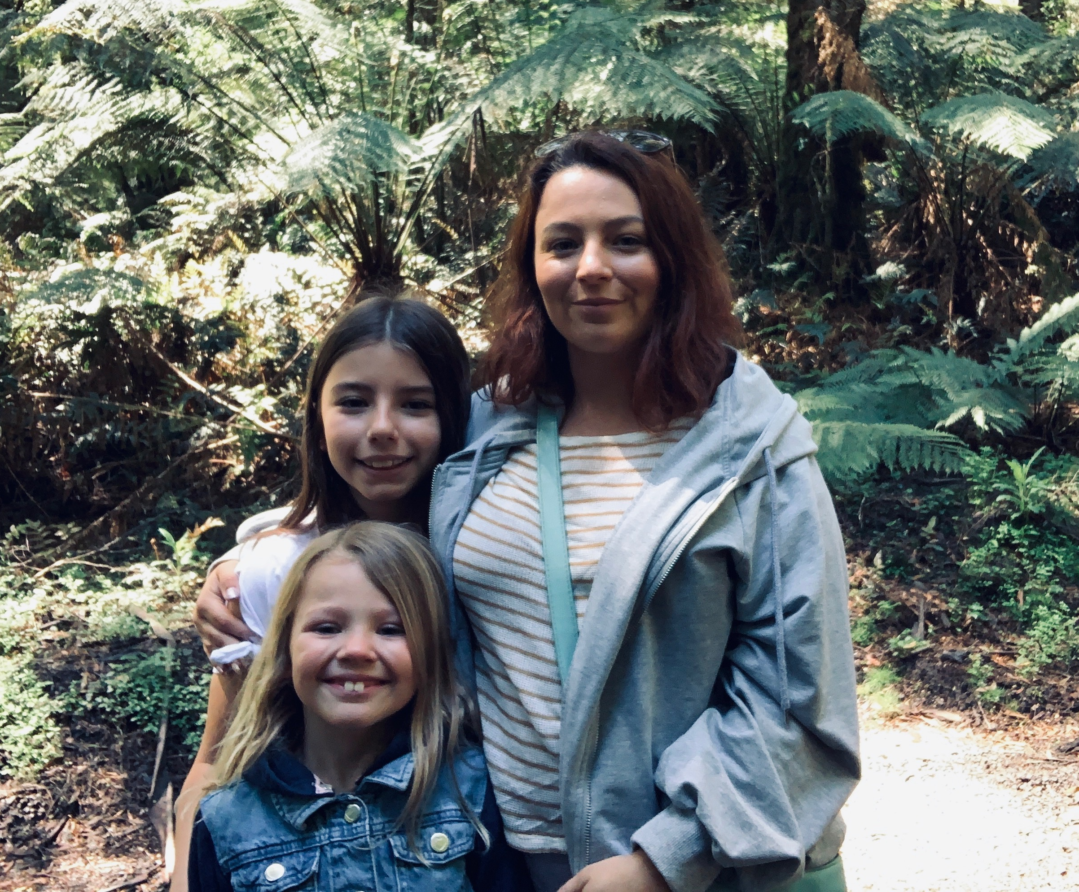
E-week of Fair and Sustainable Tourism for All
It’s not about the holiday;
it’s what the holiday brings.
Hope
Hope is being able to see that there is light despite all of the darkness.
Desmond Tutu
Kirsty’s Family Holiday, October 2019

Slide 10
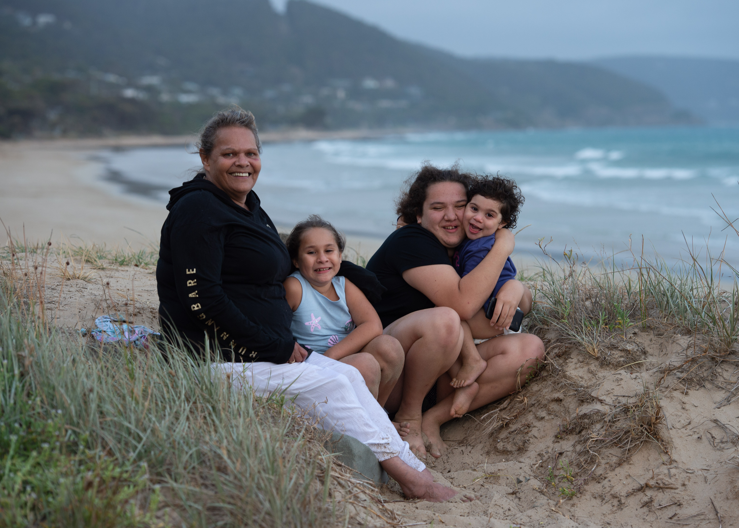
E-week of Fair and Sustainable Tourism for All
It’s not about the holiday;
it’s what the holiday brings.
Hope Created
Lifetime family memories
Social connectedness
Reduced stress and anxiety
Strengthened family communication
Increased self-esteem
Someone cares
Sumner Family Holiday, March 2019

Slide 11
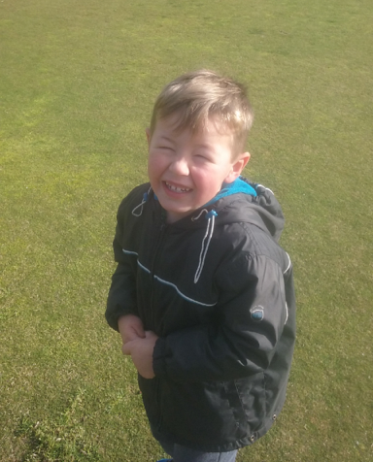
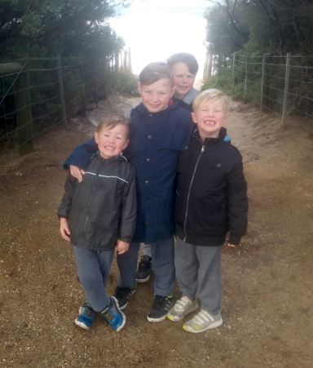
E-week of Fair and Sustainable Tourism for All
It’s not about the holiday;
it’s what the holiday brings.
These will certainly be wonderful memories for my family to keep for a lifetime.
Our experience has helped with our healing, and I believe that with each great memory puts a brick in the wall that helps build a wall away from the trauma these boys have experienced.
Their first ever holiday has given many different experiences, knowledge and memories that I would never have been able to give them by myself.
Annalise (Mum)
First Ever Family Holiday, June 2018

Slide 12
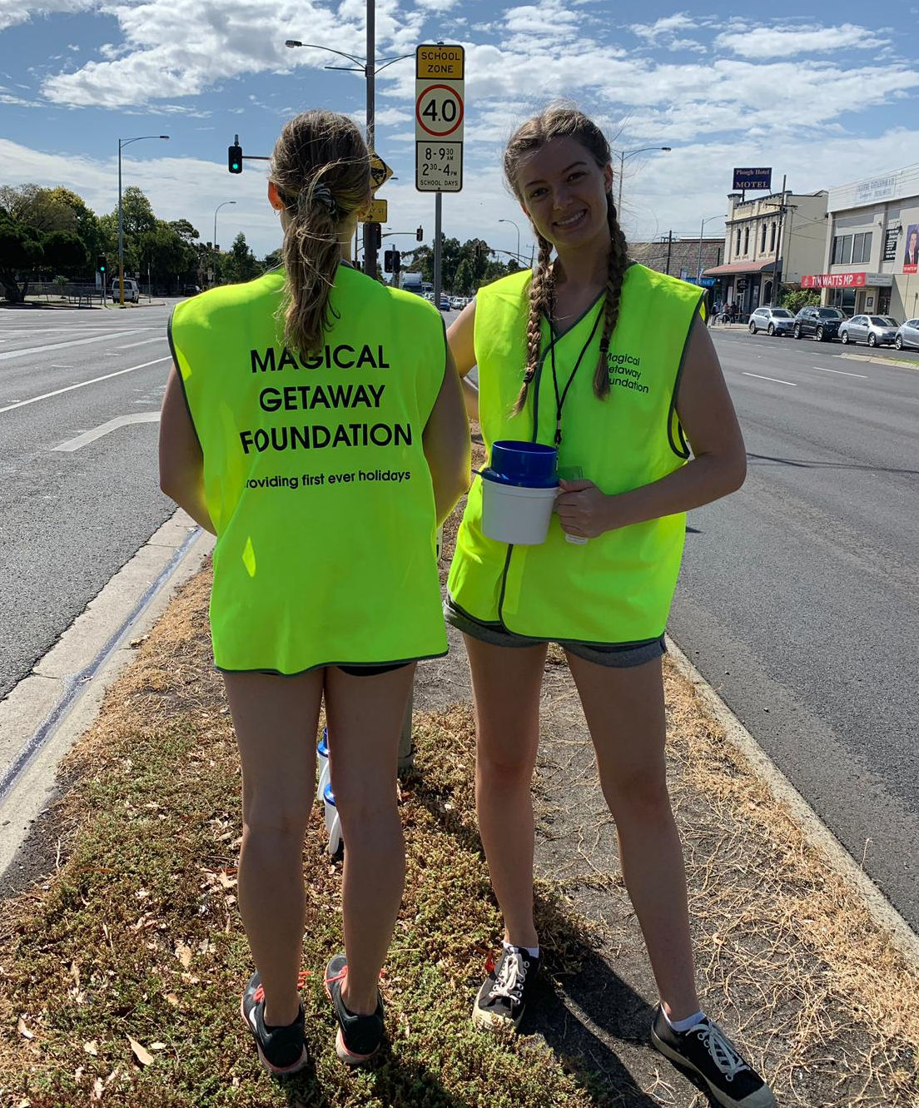
E-week of Fair and Sustainable Tourism for All
It’s not about the holiday;
it’s what the holiday brings.
Pre COVID-19
Funding Sources
Donations
Highway Collections
Gala Dinners
Social Tourism Forums
Family Fun Days
Other Events

Slide 13
E-week of Fair and Sustainable Tourism for All
It’s not about the holiday;
it’s what the holiday brings.
COVID-19
Community Impact
Stress, anxiety, concern, isolation
Unemployment / debt
Increase in domestic violence
Economic downturn
Mental health issues

Slide 14
E-week of Fair and Sustainable Tourism for All
It’s not about the holiday;
it’s what the holiday brings.
COVID-19
MGF Impact
No first ever getaways/holidays gifted
Increased waiting list
Significant decrease in donations and number of volunteers
Unable to organise direct fundraising events

Slide 15
E-week of Fair and Sustainable Tourism for All
It’s not about the holiday;
it’s what the holiday brings.
Post COVID-19
The Way Forward
Significant increase in mental health and wellbeing issues
Greater demand for first ever getaways/holidays to bring hope
Tourism; a vector for wellbeing

Slide 16
E-week of Fair and Sustainable Tourism for All
It’s not about the holiday;
it’s what the holiday brings.
Thank You for Your
Attendance
Video
www.magicalgetawayfoundation.org

